Slide 1

Using R’s Caret Package for Machine Learning
Earl F Glynn
Kansas City R Users Group
9 September 2017
https://github.com/EarlGlynn/kc-r-users-caret-2017

Slide 2
Using R’s Caret Package for Machine Learning
Regressions Models vs Machine Learning
Caret Package Overview
Visualize Data
Preprocess / Transform Data
Partition Data into Train and Test Sets
Train and Tune Model
Evaluate Model Performance
Estimate Variable Importance
Parallel Processing
Caret Machine Learning: Forensic Glass Dataset
Toy Shiny App to Compare Machine Learning Models
Summary

Slide 3

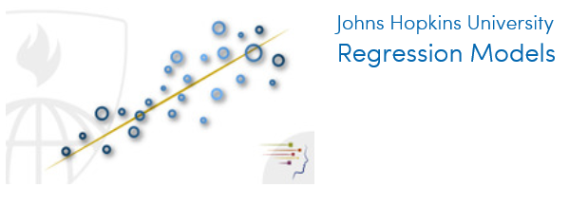

Regression Models vs. Practical Machine Learning
Focus: Interpretability
Focus: Accurate Predictions
https://www.coursera.org/specializations/jhu-data-science

Slide 4


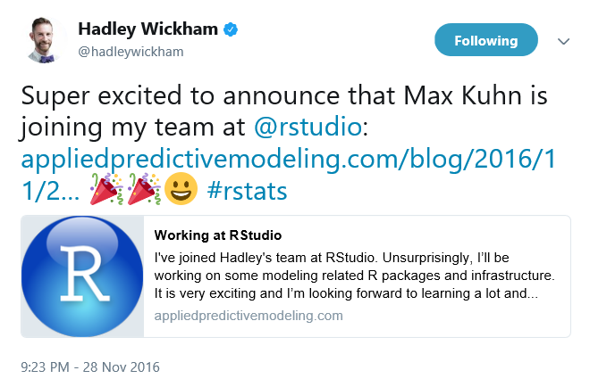
Caret Package: Classification And Regression Training
https://github.com/topepo/caret
2013
http://appliedpredictivemodeling.com/
http://appliedpredictivemodeling.com/blog/

Slide 5
Caret Package Features
Provides uniform interface to machine learning models
Streamlines model training and tuning
Standardizes common tasks
Uses dozens of R packages
Provides parallel processing
Building Predictive Models in R Using the caret Package
https://www.jstatsoft.org/article/view/v028i05/v28i05.pdf
Max Kuhn, Pfizer Global R&D
Journal of Statistical Software, Nov. 2008

Slide 6
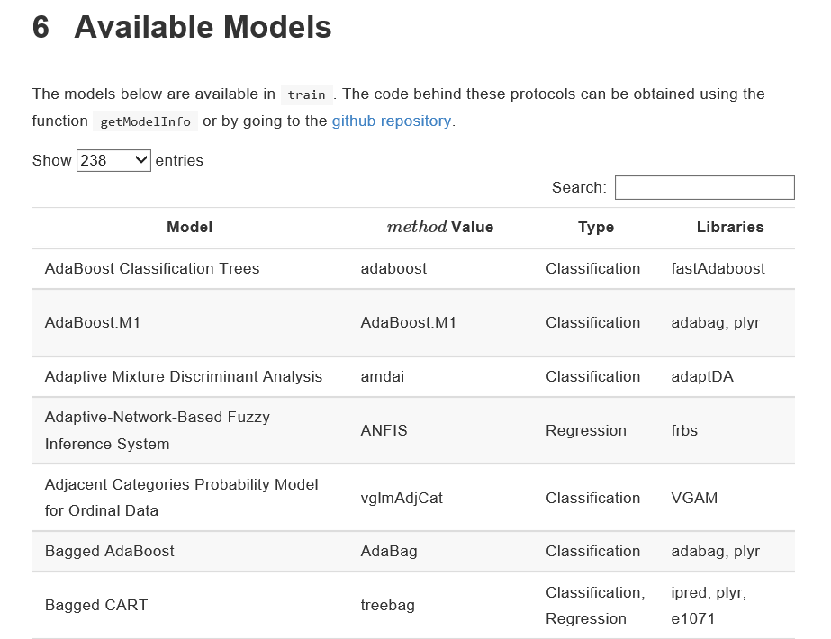
Caret Package Models
http://topepo.github.io/caret/modelList.html
Files: caret-overview.Rmd and caret-overview.html

Slide 7
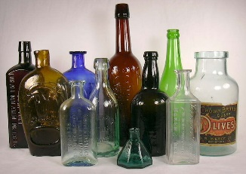
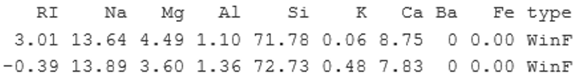
Forensic Glass Dataset
https://sha.org/bottle/links.htm
fgl dataset in MASS package
RI = refractive index
Percentages by weight of oxides: Na, Mg, Al, Si, K, Ca, Ba, Fe
type
window float glass (WinF: 70),
window non-float glass (WinNF: 76),
vehicle window glass (Veh: 17),
containers (Con: 13),
tableware (Tabl: 9)
vehicle headlamps (Head: 29).
Also available through UCI Repository.
Discussed in book Data Mining and Business Analytics with R.

Slide 8
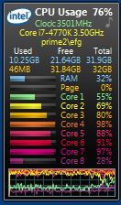
Caret: Parallel Processing
On a PC …
# Setup parallel processing
# Let's use 6 cores
library(doParallel)
rCluster <- makePSOCKcluster(6) registerDoParallel(rCluster)
…
stopCluster(rCluster)

Slide 9
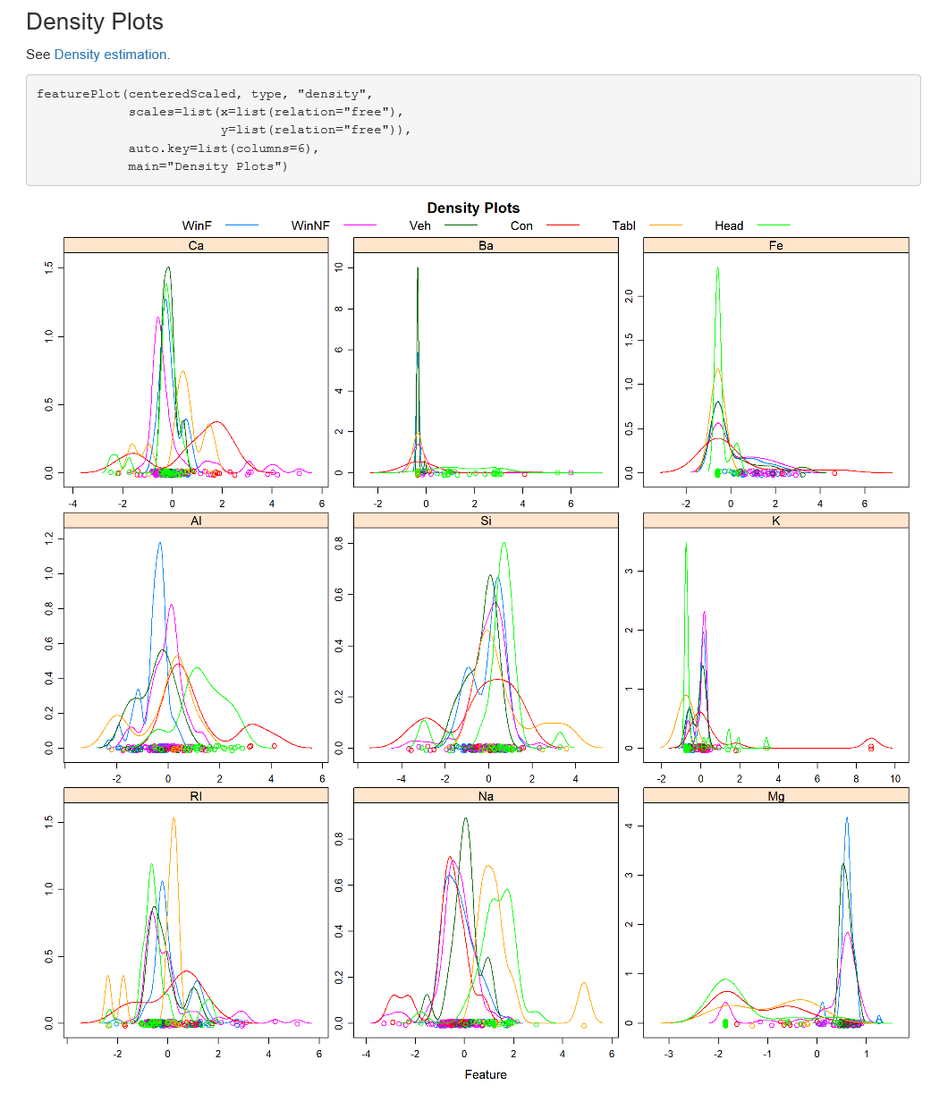
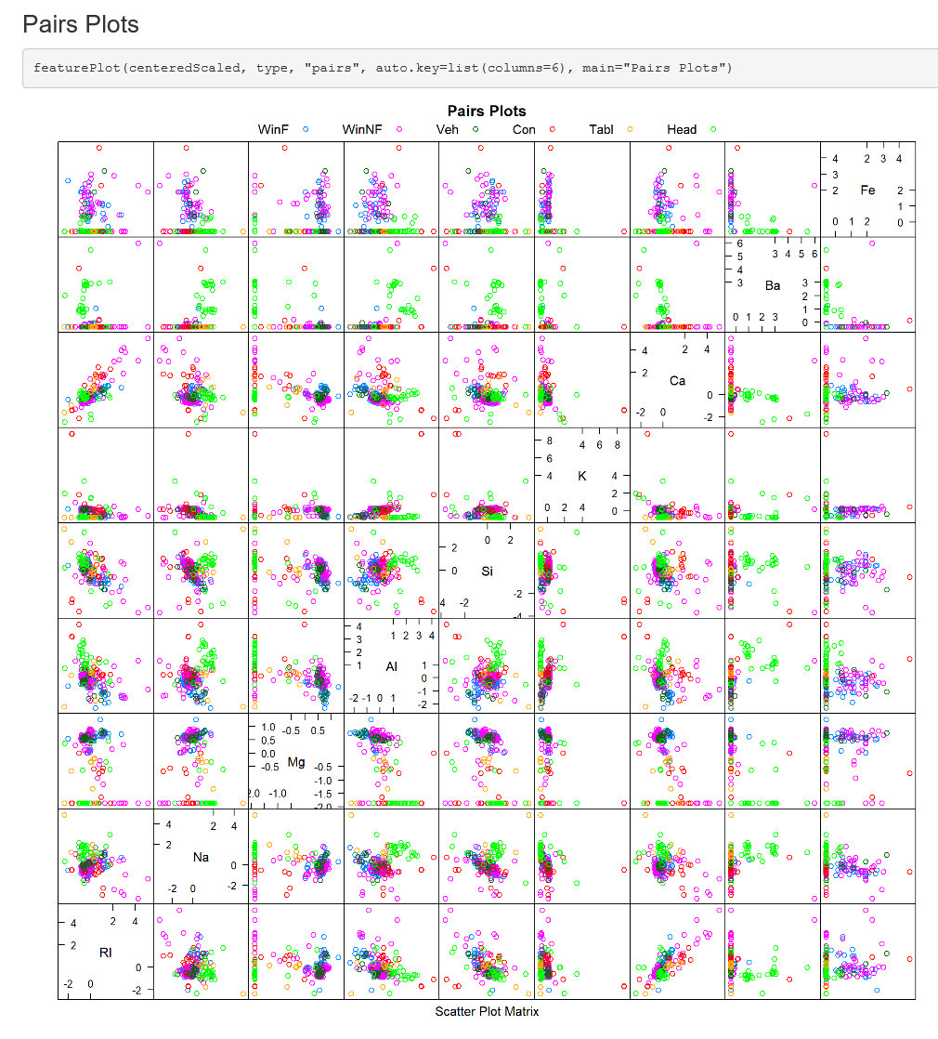
Caret: Visualize Data
Files: Forensic-Glass-Exploratory.Rmd or Forensic-Glass-Exploratory.html
Data Visualization with the Caret R package
https://machinelearningmastery.com/data-visualization-with-the-caret-r-package/

Slide 10
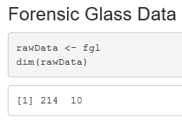
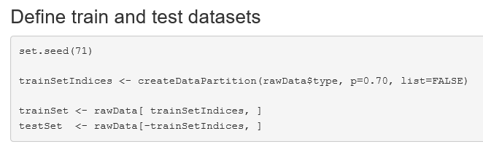
Caret: Partition Data into Train & Test
Use function createDataPartition to create splits of the data

Slide 11
Caret: Partition Data into Train & Test
Use function createDataPartition to create splits of the data.
http://topepo.github.io/caret/data-splitting.html
Approach Using Forensic Glass Dataset
214 glass samples each with 9 predictors
Split original dataset: 70% training, 30% final test
153 samples training
61 samples final test
Use for training and tuning
Use once and only once for
final test of model. Why?

Slide 12
Caret: Preprocess / Transform Data
• Impute Missing Values
Create Dummy Variables
• Remove Zero- / Near Zero-Variance Predictors
• Remove Correlated Predictors
• Remove Linear Dependencies
• Center / Scale / Standardize Data
Transformations (BoxCox, YeoJohnson)
http://topepo.github.io/caret/pre-processing.html

Slide 13
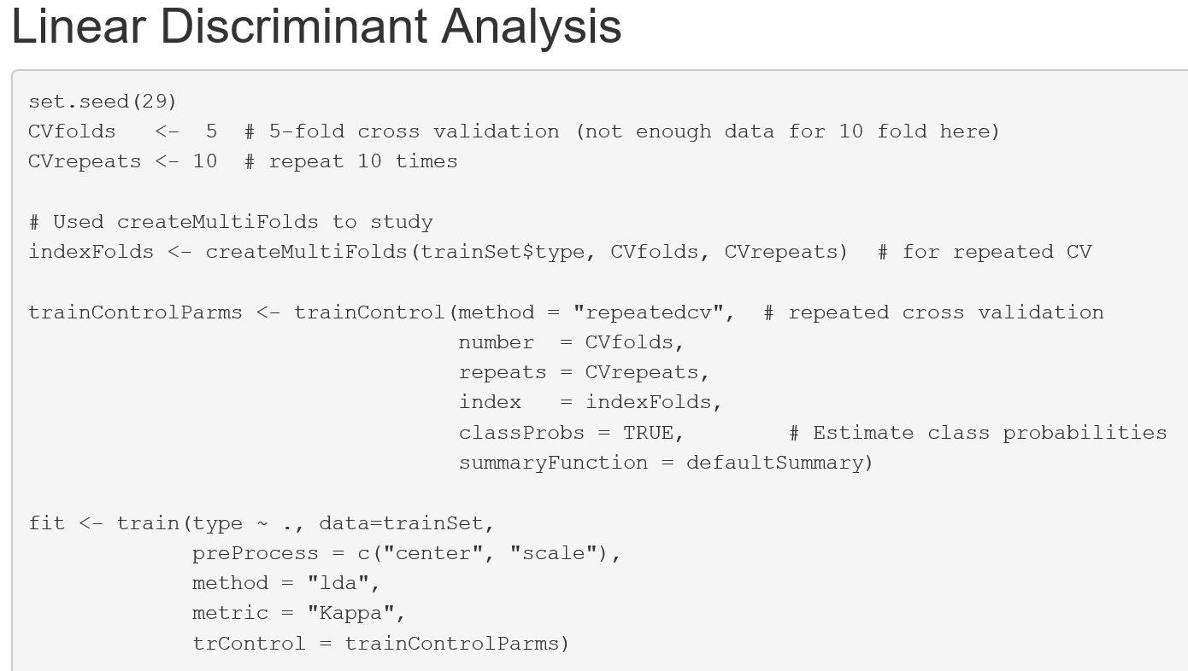
Caret: Train Model
Files: Forensic-Glass-caret-rf.Rmd and Forensic-Glass-caret-rf.html

Slide 14

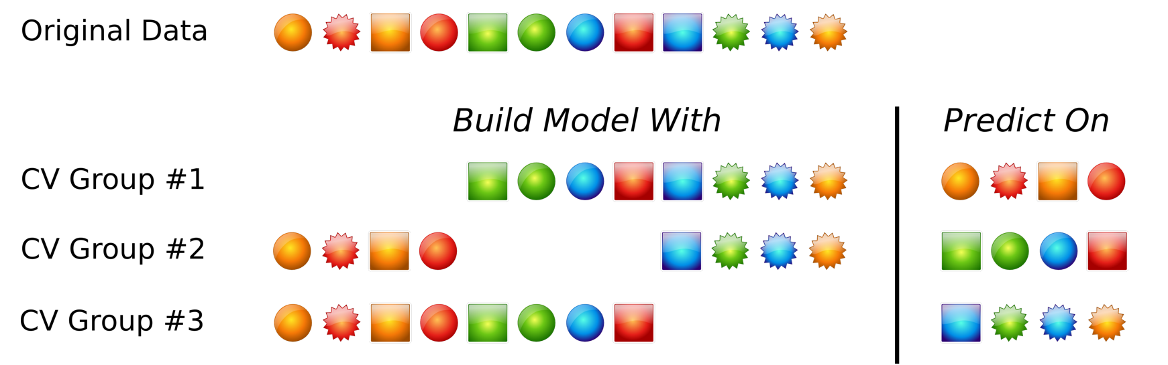
Caret: Train Model
https://opendatascience.com/conferences/predictive-modeling-workshop-max-kuhn/

Slide 15
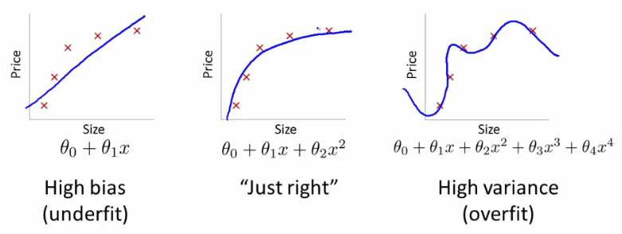
Underfit vs Overfit
Bias-Variance Tradeoff
https://datascience.stackexchange.com/questions/361/when-is-a-model-underfitted

Slide 16
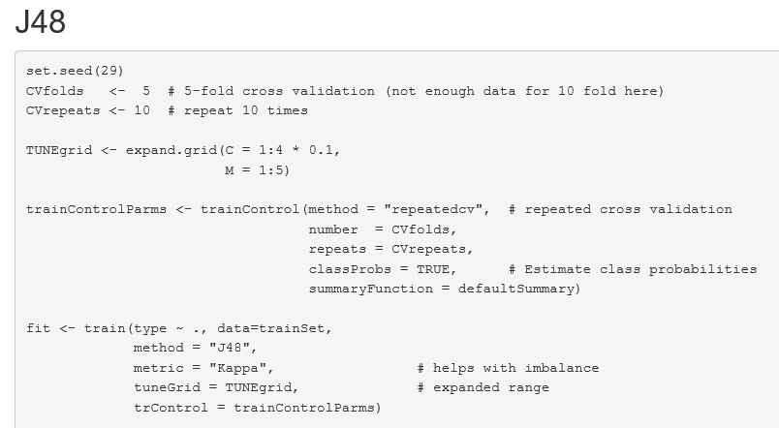
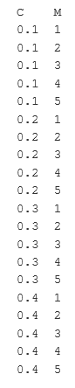
Caret: Tune Model
Hyperparameters
Often default tuning is adequate, but when not …
Files: Forensic-Glass-caret-J48.Rmd and Forensic-Glass-caret-J48f.html
Tune Machine Learning Algorithms in R (random forest case study)
https://machinelearningmastery.com/tune-machine-learning-algorithms-in-r/

Slide 17
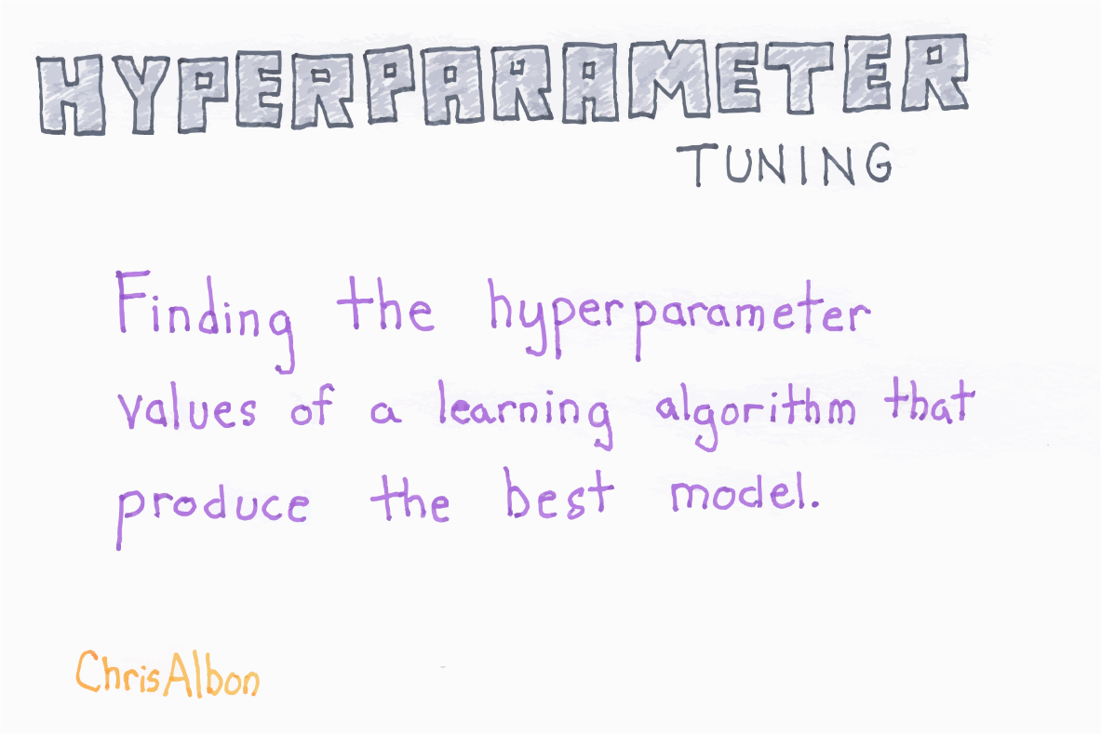
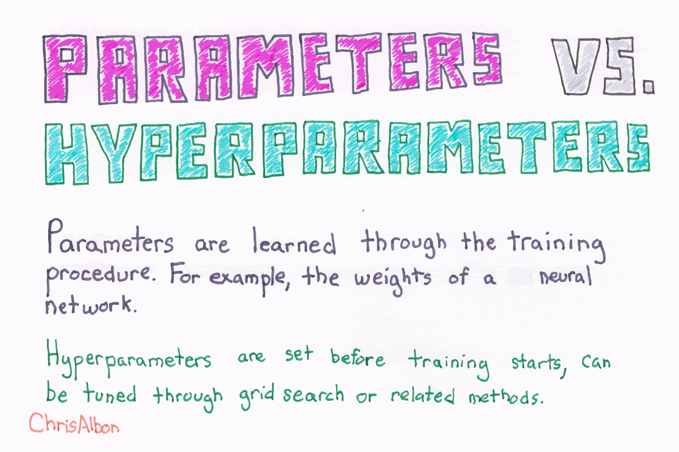
@ChrisAlbon
MachineLearningFlashcards.com

Slide 18
Caret: Evaluate Model Performance
Classification Metrics
Accuracy
Area Under Curve (AUC) [2 classes]
Kappa (better than Accuracy when groups not balanced)
LogLoss
Regression Metrics
RMSE (Root Mean Squared Error)
R²

Slide 19
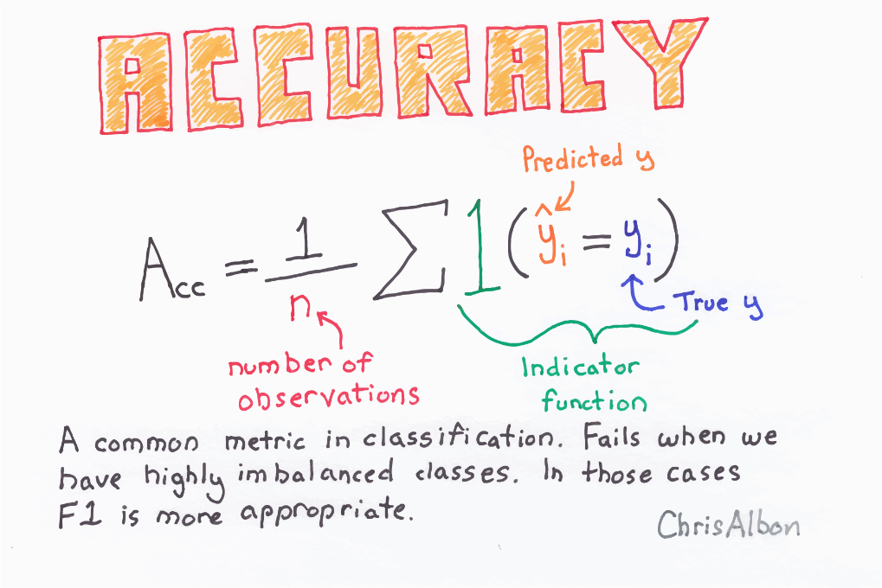
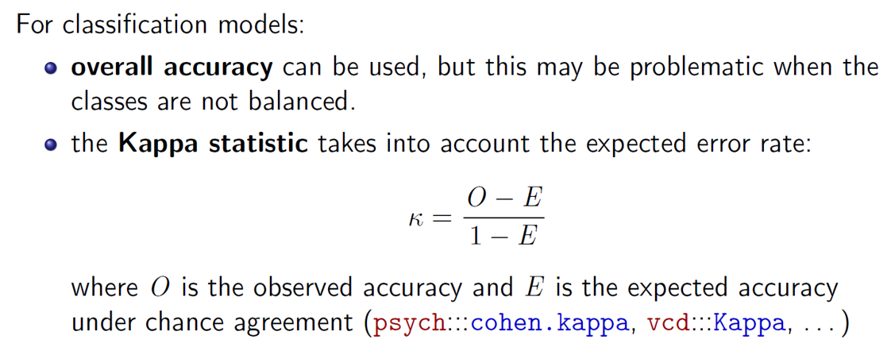
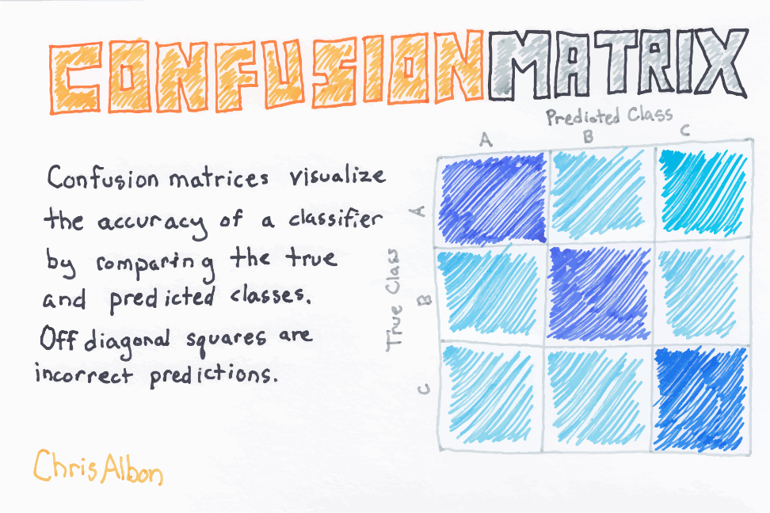
Caret: Evaluate Model Performance
Kappa
https://www.r-project.org/conferences/useR-2013/ Tutorials/kuhn/user_caret_2up.pdf
@ChrisAlbon
MachineLearningFlashcards.com

Slide 20
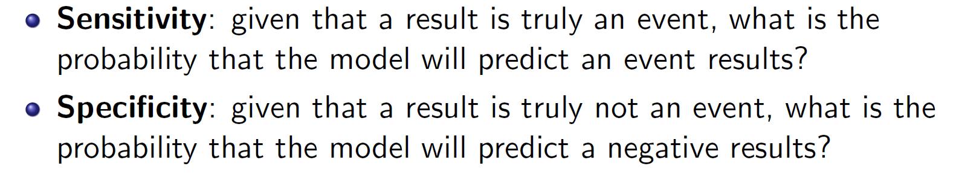
Caret: Evaluate Model Performance
https://www.r-project.org/conferences/useR-2013/Tutorials/kuhn/user_caret_2up.pdf

Slide 21
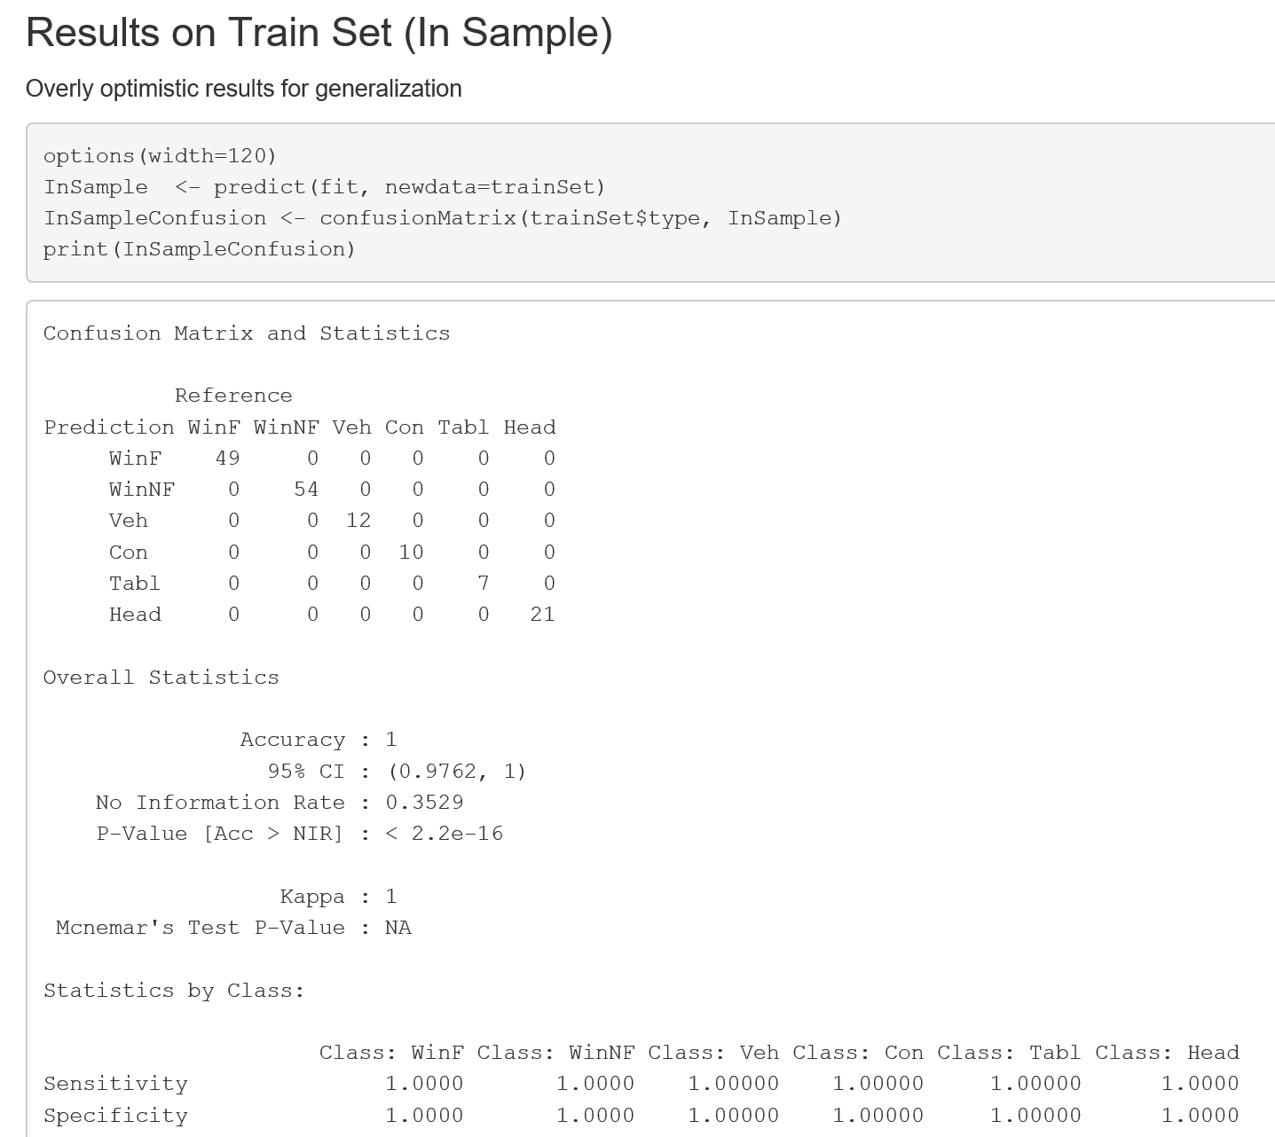
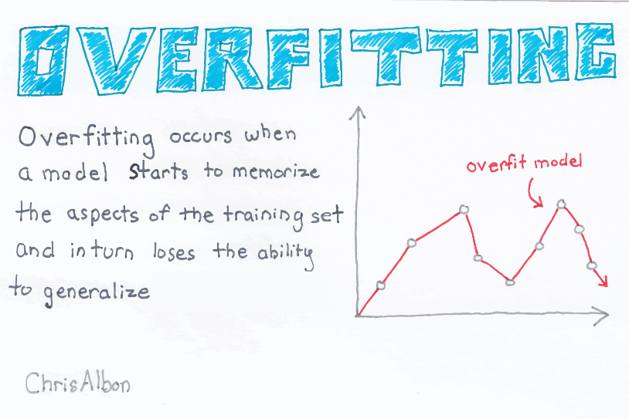
Caret: Evaluate Model Performance
Train: Overly Optimistic Results for Generalization
@ChrisAlbon
MachineLearningFlashcards.com
Files: Forensic-Glass-caret-rf.Rmd and Forensic-Glass-caret-rf.html

Slide 22
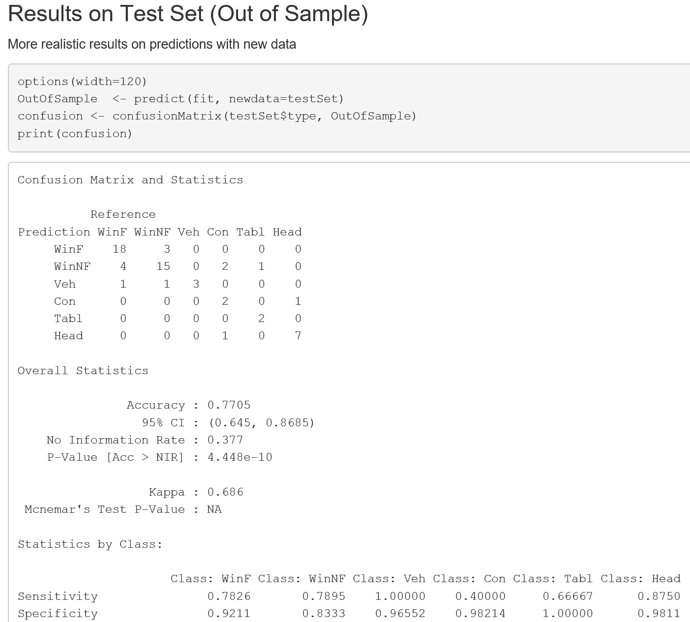
Caret: Evaluate Model Performance
Test: More Realistic Results on Predictions with New Data
Files: Forensic-Glass-caret-rf.Rmd and Forensic-Glass-caret-rf.html

Slide 23
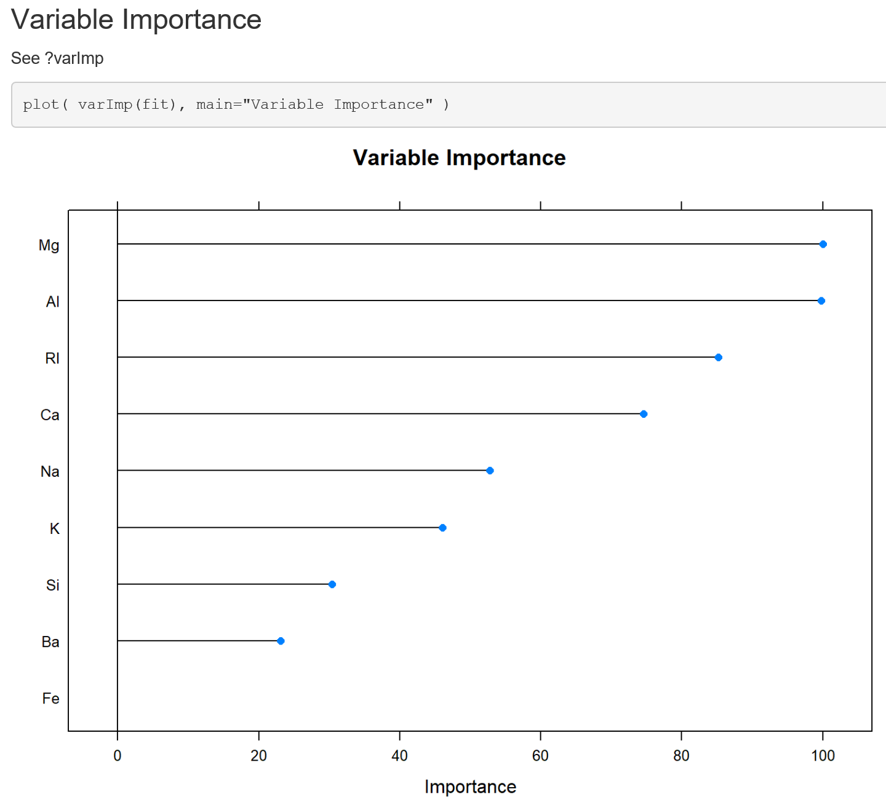
Caret: Estimate Variable Importance
Random Forest: Single Prediction Model
Files: Forensic-Glass-caret-rf.Rmd and Forensic-Glass-caret-rf.html

Slide 24
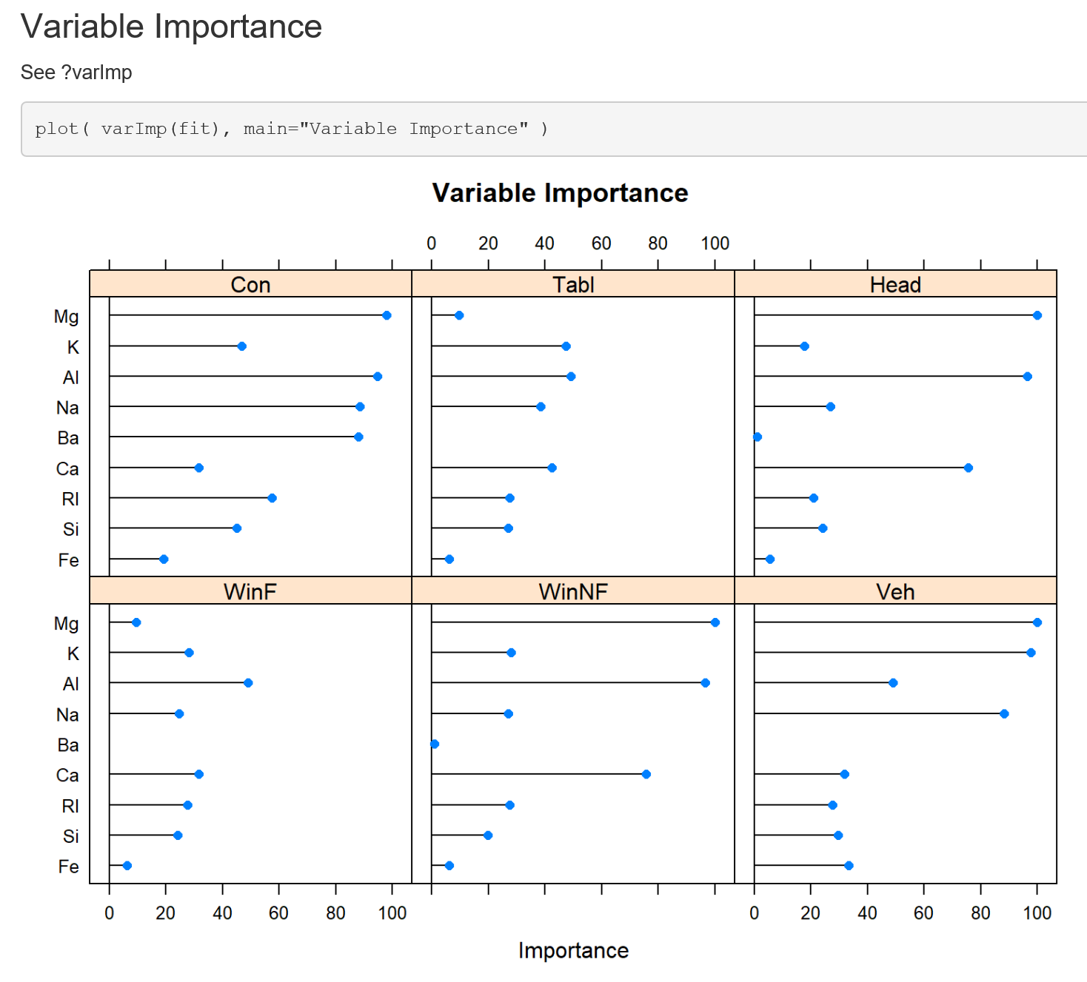
Caret: Estimate Variable Importance
J48: Separate Model for Each Type
Files: Forensic-Glass-caret-J48.Rmd and Forensic-Glass-caret-J48.html

Slide 25
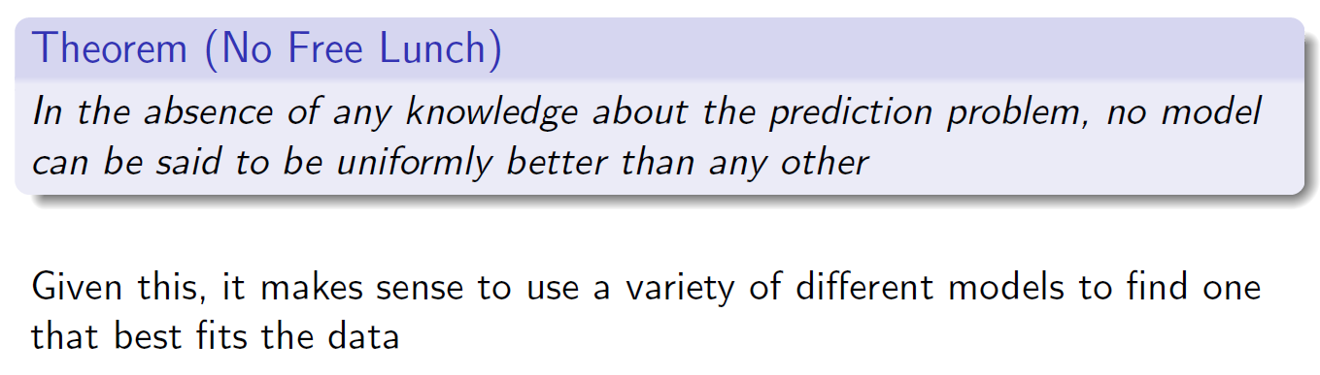
Caret Machine Learning
Which Machine Learning Algorithms to use?
https://www.r-project.org/conferences/useR-2010/slides/Kuhn.pdf

Slide 26
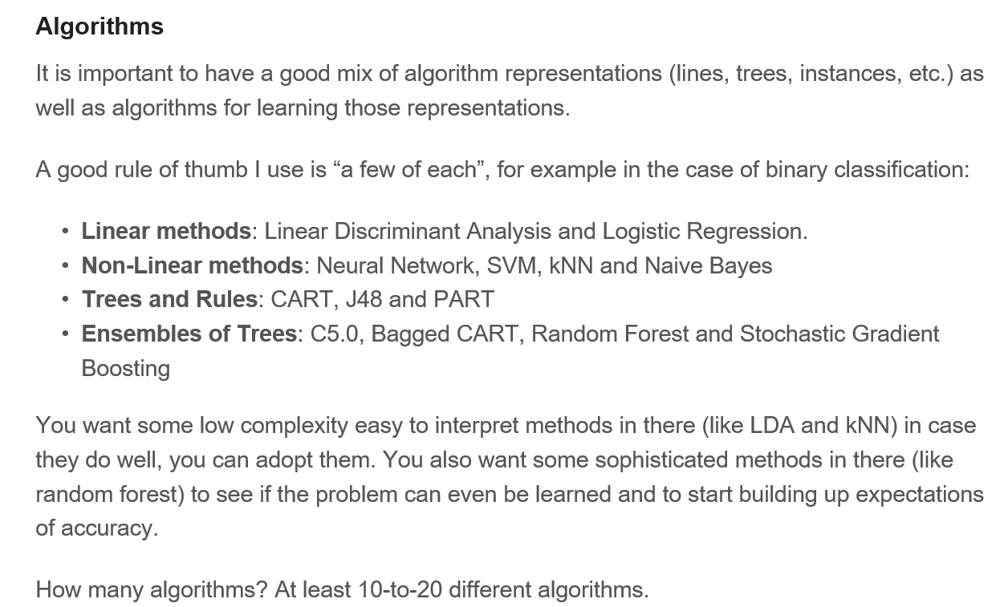
Caret Machine Learning
Which Machine Learning Algorithms to use?
https://machinelearningmastery.com/evaluate-machine-learning-algorithms-with-r/, Jason Brownlee

Slide 27
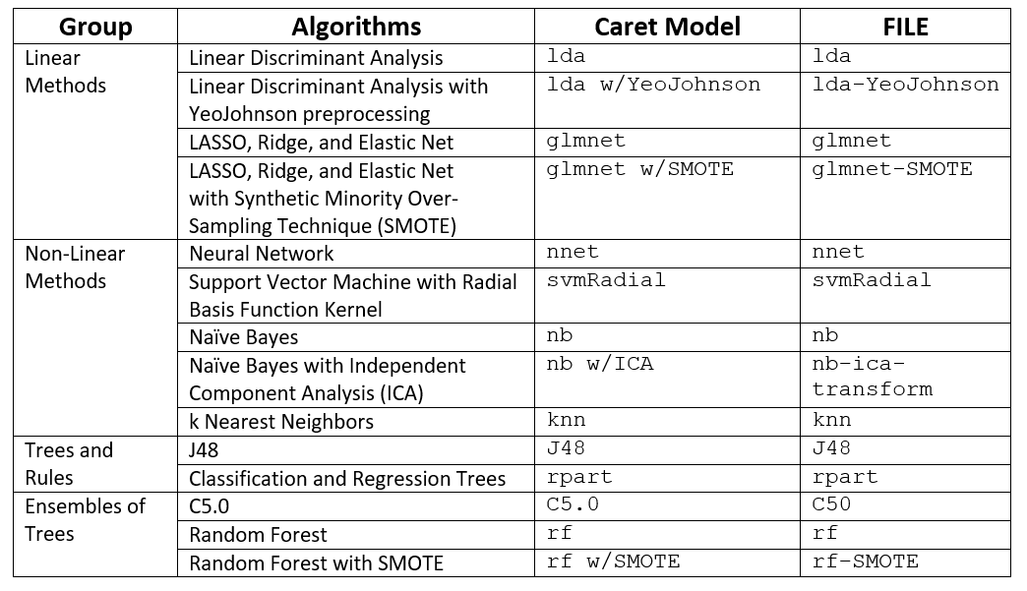
Caret Machine Learning Examples
Files: Forensic-Glass-caret-FILE.Rmd and Forensic-Glass-caret-FILE.html

Slide 28
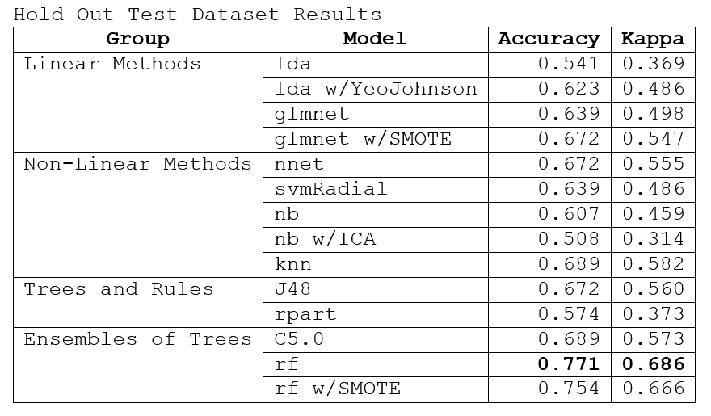
Summary of Results From Variety of Machine Learning Methods

Slide 29
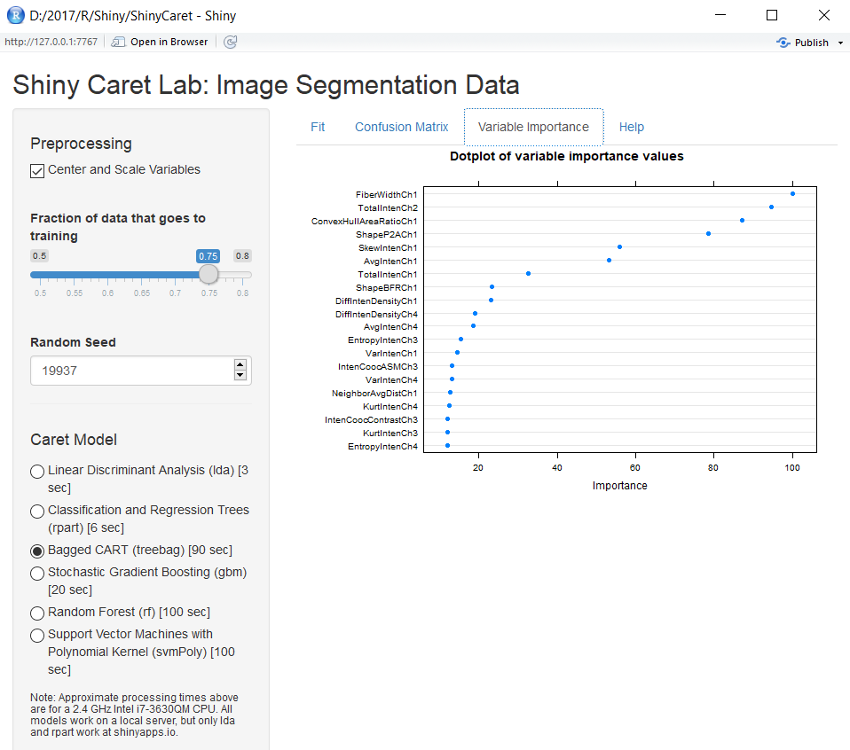
Toy Shiny App To Compare Models
Open ShinyCaret Folder as project in RStudio. Open file server.R. Select Run App.

Slide 30
Machine Learning Algorithms Using R’s Caret Package Summary
Caret provides uniform approach to using many classification and regression algorithms
Many machine algorithms can be explored quickly using Caret.
Caret provides many useful tools for machine learning

Slide 31
Question
Do We Need Hundreds of Classifiers to Solve Real World Classification Problems? http://jmlr.org/papers/volume15/delgado14a/delgado14a.pdf

Slide 32
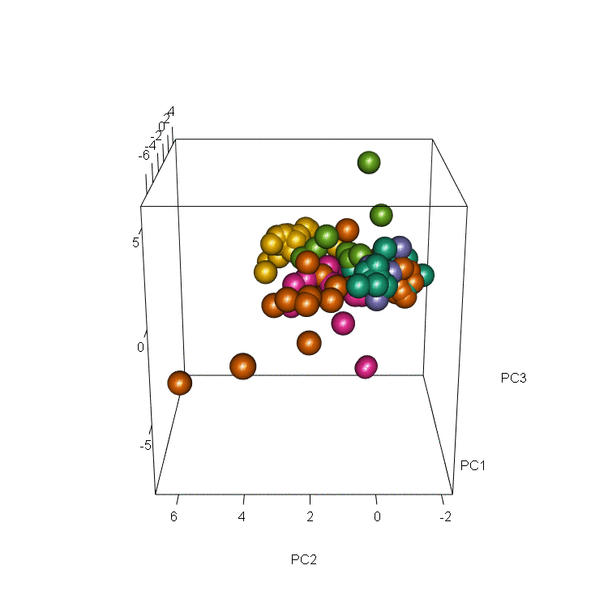
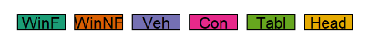
Forensic Glass Dataset: PCA
Files: Forensic-Glass-PCA.Rmd and Forensic-Glass-PCA.html

